Slide 1

Project Title - Seasonal Agriculture Performance Analysis
Roobika Rangaraj
Jai Shriram Engineering College
AICTE STU ID : STU6a6b0fac485711785401260

Slide 2

PROBLEM STATEMENT
Agricultural activities are influenced by seasonal variations in environmental conditions, farming practices, resource availability and market conditions. As a result, agricultural performance may differ from one season to another. However, raw agricultural data does not clearly explain how agricultural performance changes across seasons or what patterns can be observed in different seasonal conditions. The problem is to analyze the given agricultural dataset and investigate seasonal differences in agricultural performance by identifying meaningful patterns, trends, relationships and variations within the available data.

Slide 3
Project Description
Cleaned and explored the agricultural dataset using Python and Pandas. Compared Kharif, Rabi and Zaid seasons using yield, production, revenue, cost and profit.
Environmental and resource variables such as rainfall, temperature, humidity, soil moisture, fertilizer, pesticide and water usage were also analyzed.
Statistical analysis, correlation analysis and student-designed comparisons were used to identify meaningful seasonal patterns and support recommendations.

Slide 4

WHO ARE THE END USERS?
Farmers – seasonal crop selection and resource planning.
Agricultural planners – seasonal resource allocation and performance monitoring.
Agribusiness teams – production, profitability and crop planning.
Researchers / students – understanding relationships between climate, resources and agricultural performance.

Slide 5

Technology Used
Python
Google Colab
Pandas & NumPy
Matplotlib & Seaborn
SciPy for statistical analysis
GitHub for version sharing

Slide 6
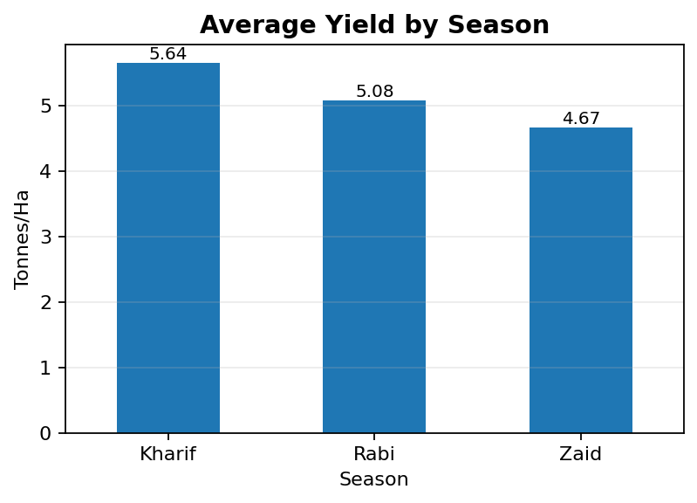

RESULTS – Seasonal Performance
Average Yield by Season
Average Production by Season

Slide 7
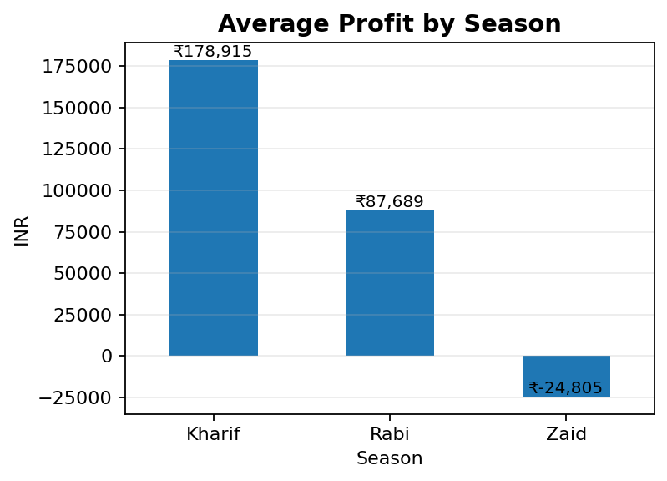
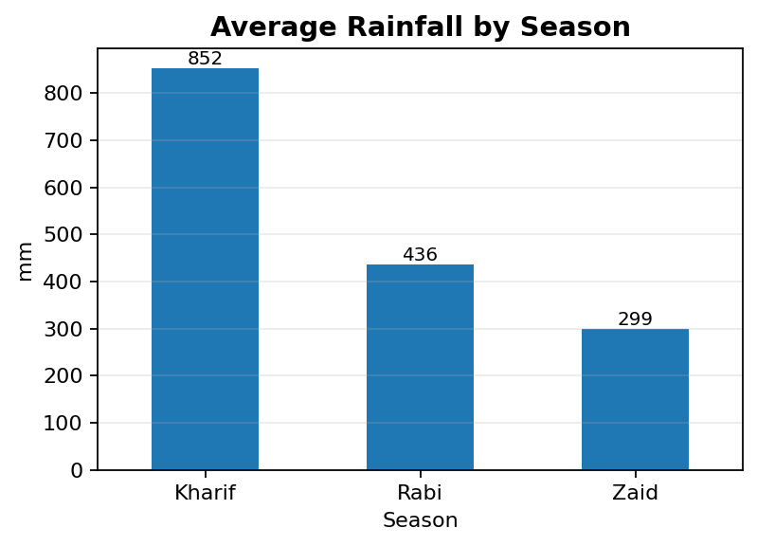
RESULTS – Profitability & Rainfall
Average Profit by Season
Average Rainfall by Season

Slide 8
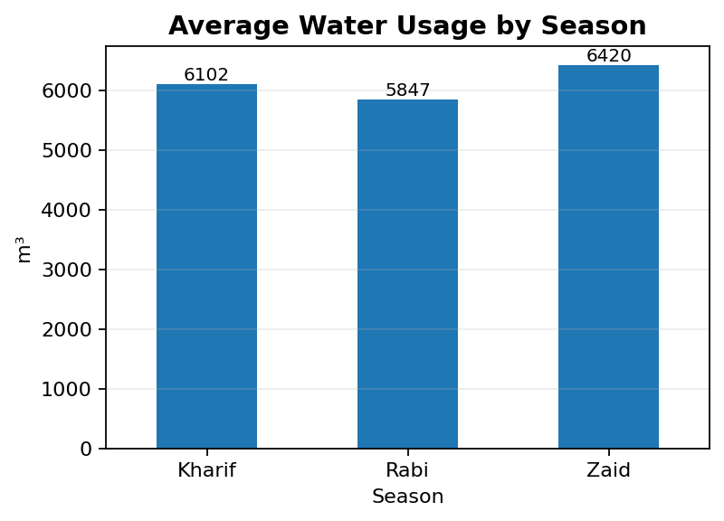
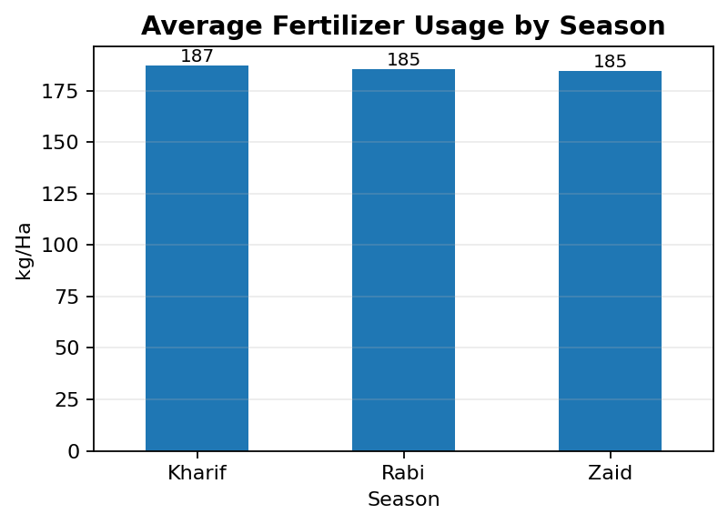
RESULTS – Resource Usage
Average Water Usage by Season
Average Fertilizer Usage by Season

Slide 9
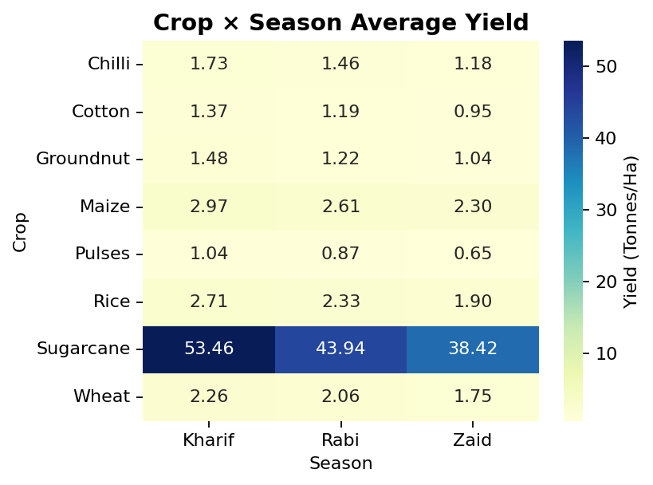
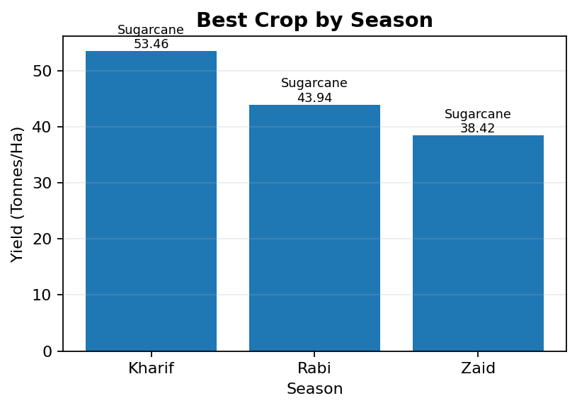
RESULTS – Crop × Season Analysis
Crop × Season Average Yield
Best Crop by Season

Slide 10
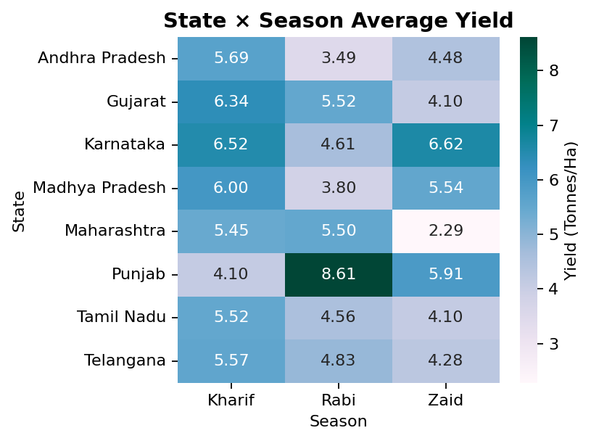
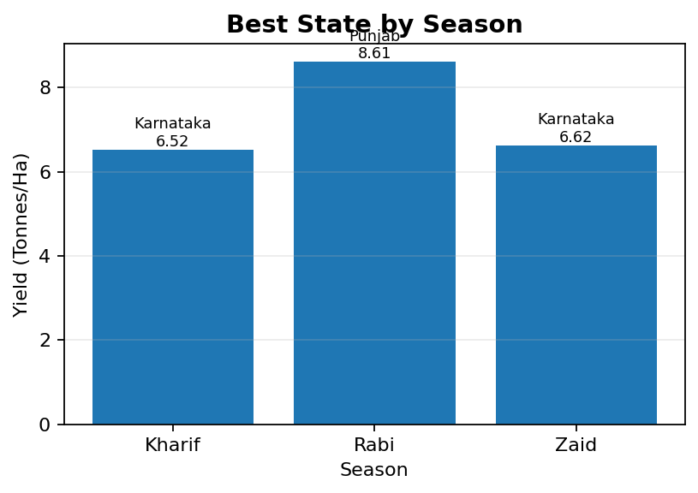
RESULTS – State × Season Analysis
State × Season Average Yield
Best State by Season

Slide 11
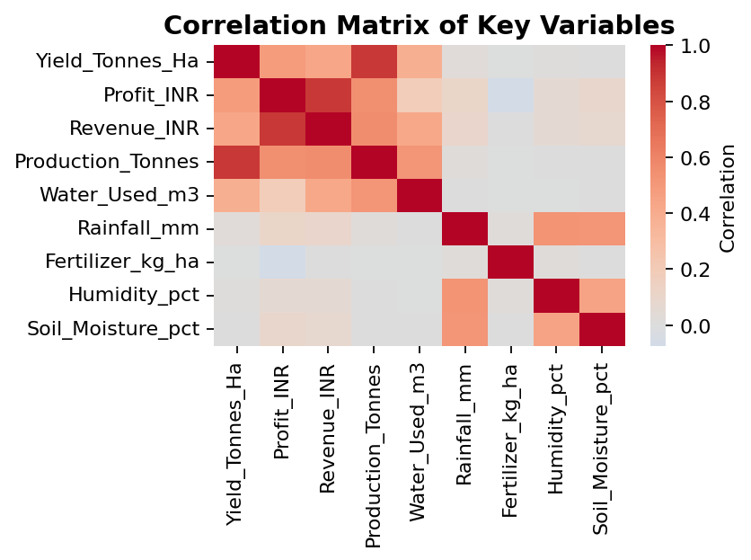
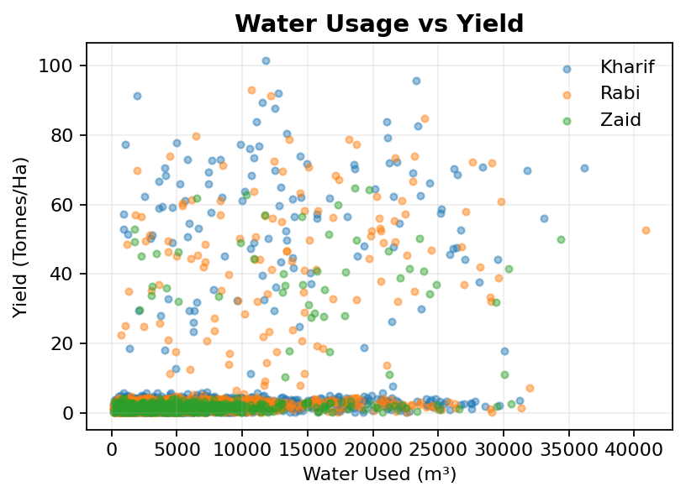
RESULTS – Correlation & Student Analysis
Correlation Matrix of Key Variables
Water Usage vs Yield

Slide 12
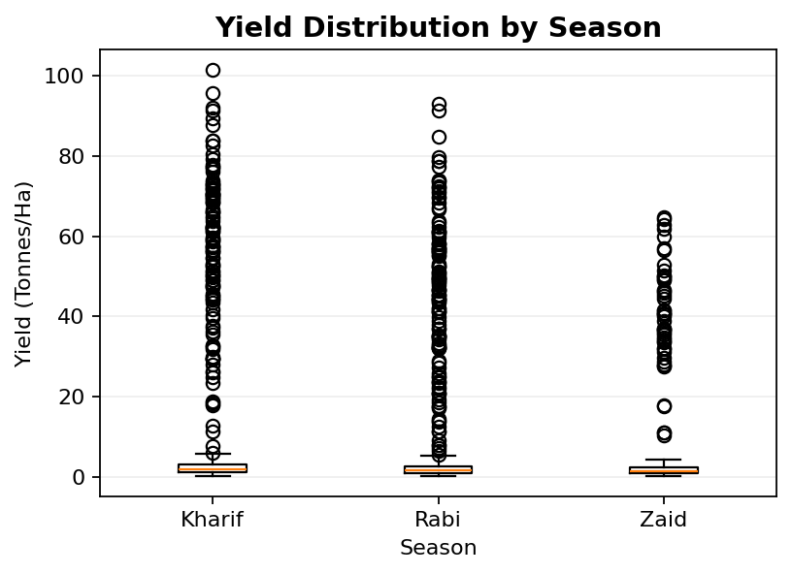
RESULTS – Statistical Analysis
Yield Distribution by Season
ANOVA Result
One-way ANOVA on yield across Kharif, Rabi and Zaid: F-statistic = 1.458 p-value = 0.233 At the 5% significance level, the seasonal yield differences are not statistically significant based on this test.

Slide 13
Recommendations & Future Scope
Recommendations
• Use crop–season performance when planning crop selection.
• Plan irrigation using rainfall and soil-moisture patterns.
• Monitor water use because higher water use does not automatically mean higher yield.
• Focus on seasonal profitability, not yield alone.
Future Scope
• Add multi-year data to study long-term seasonal trends.
• Include market price and demand variables.
• Add more locations and crop varieties.
• Build an interactive dashboard for decision support.

Slide 14
GitHub Link
https://github.com/roobi2003/Seasonal_Agriculture_Performance_Analysis.ipynb/tree/main

Slide 15

VOIS Course Completion Certificate
Course Name - Data Visualization

Slide 16
Thank you

